Slide 1
PU2025-18- FTQ improvement for BR10 VOP- RR1 test NOK
Division Power System I Business Excellence
Project Leader: Mr. Ganesh Hole
Team Member(s): Mr. Shahiraj Shelar- Prod., Mr. Ramesh Sawant- Prod., Mr. Shriram Sutar- QA, Mr. Vaibhav Jogade- QA
Date range: 10 Feb 2025- 31 Dec 2025

Slide 2
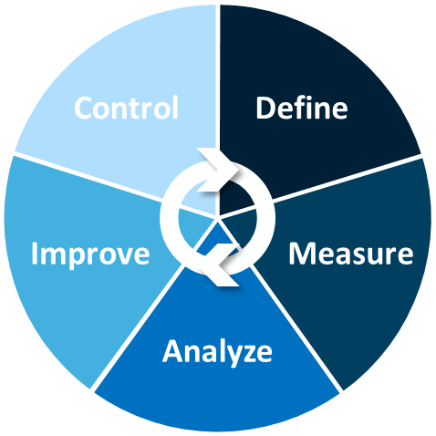
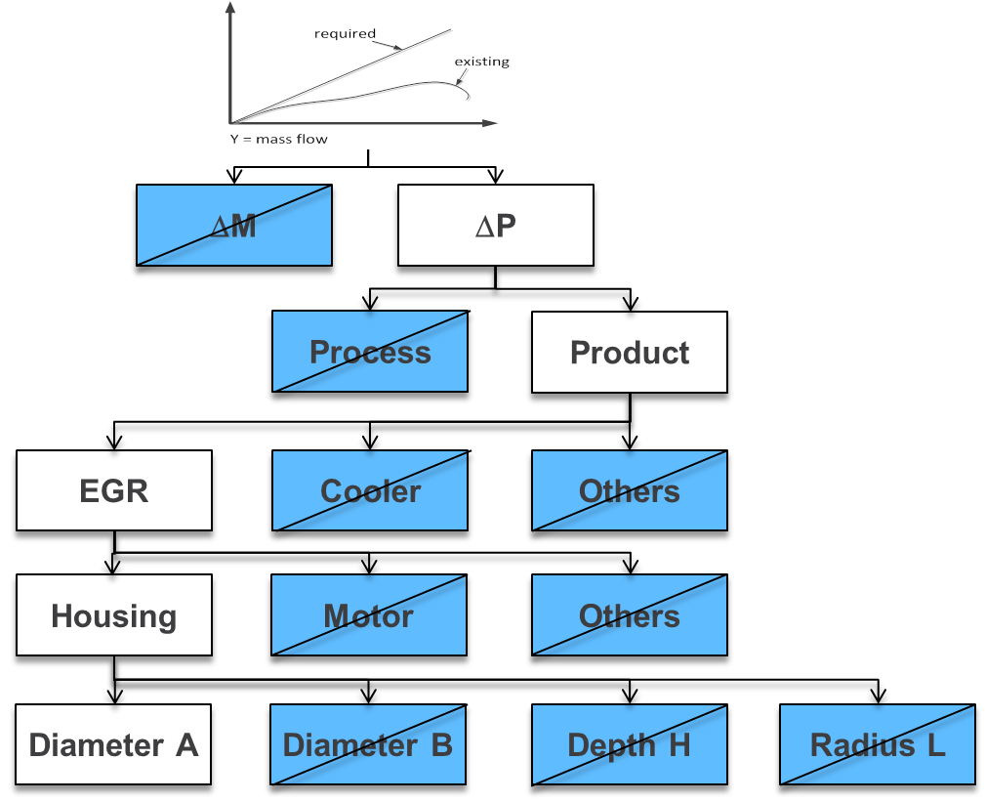
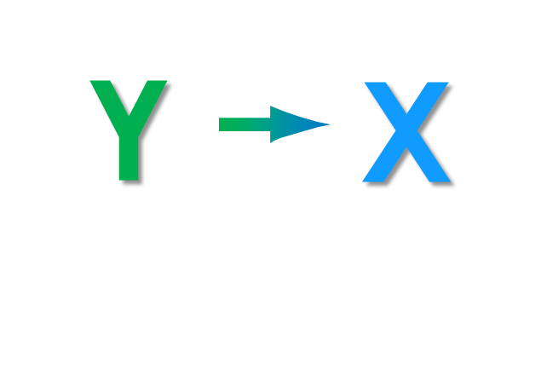
Table of Contents
: PU2025-18- FTQ improvement for BR10 VOP- RR1 test NOK
DMAIC Summary
  Define
  Measure
Mone(Y) = Mass Flow [kg/s]
  Analyze
  Improve
  Control
BIG X
Elimination Strategy

Slide 3
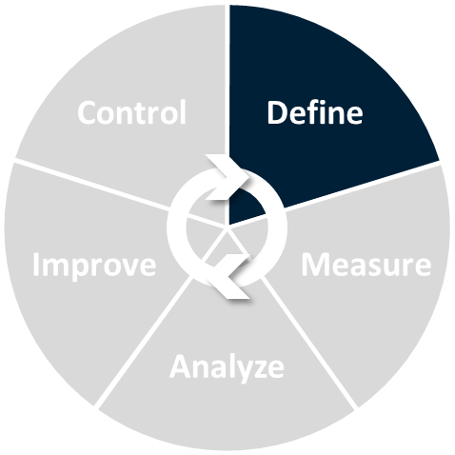

DEFINE
: PU2025-18- FTQ improvement for BR10 VOP- RR1 test NOK
DMAIC - DEFINE
Possible required tools like:
Project Basics --------------------------------
Problem Definition Tree--------------------
Project Definition Tree ---------------------
Pareto Chart ---------------------------------
Time Series Plot -----------------------------
Histogram ------------------------------------
Mone(Y) = Mass Flow [kg/s]
BIG X
Elimination Strategy

Slide 4
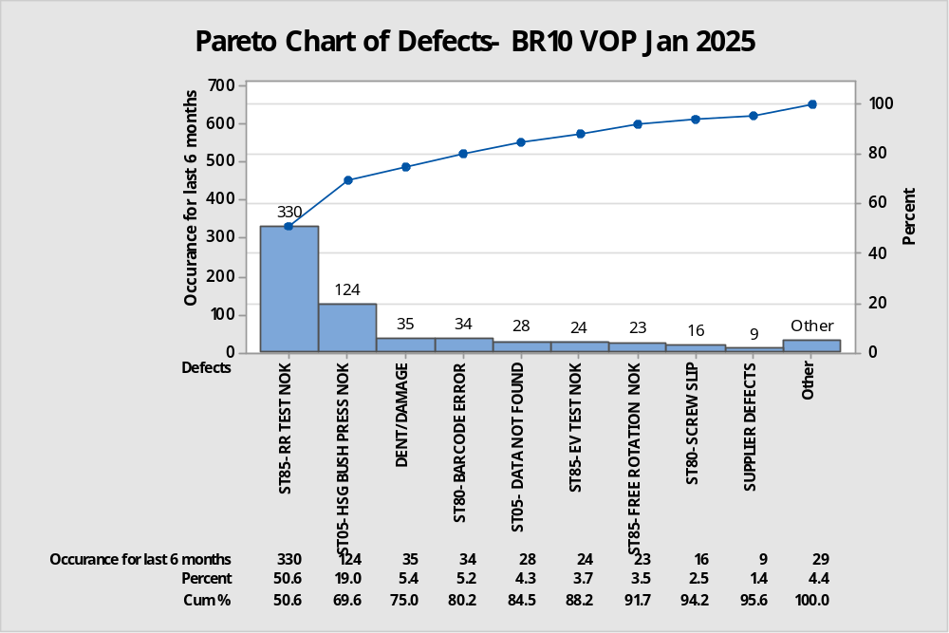
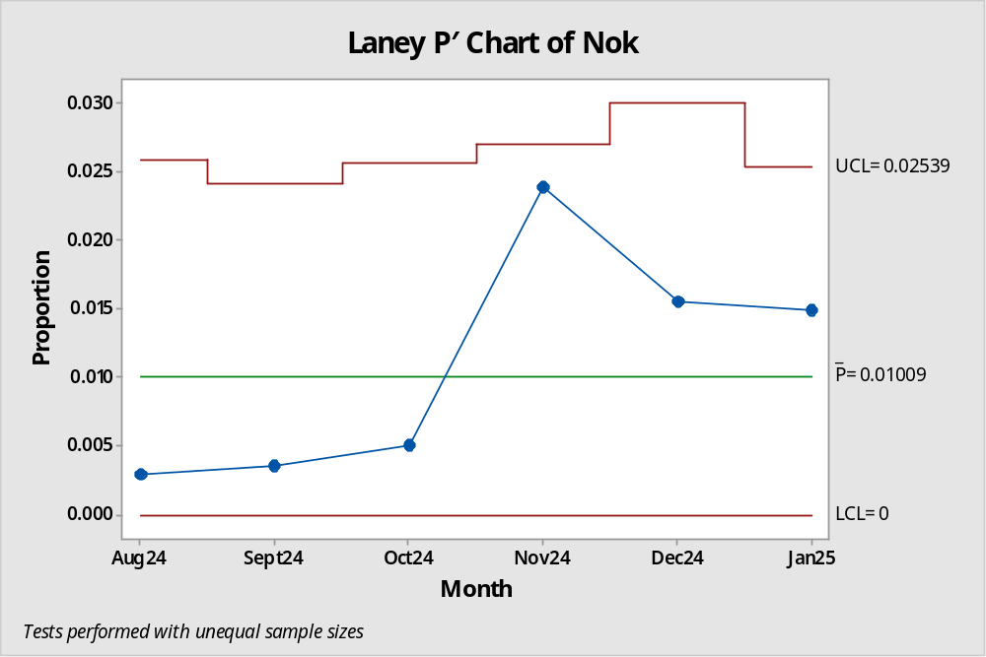
Project Basics:
: PU2025-18- FTQ improvement for BR10 VOP- RR1 test NOK
DMAIC - DEFINE
Conclusion:
RR1 test nok is the top most FTQ concern for BR10 VOP
For Last 6 months average rejection percentage is 1.10%
For Jan 2025 current rejection percentage is 1.49%

Slide 5
Define
: PU2025-18- FTQ improvement for BR10 VOP- RR1 test NOK
Project Basics
DMAIC - DEFINE
Team Members:
Mr. Shahiraj Shelar- Prod.
Mr. Ramesh Sawant- Prod.
Mr. Shriram Sutar- QA
Mr. Vaibhav Jogade- QA
Project Start Date: 10 Feb 2025
Project End Date: 31 Dec 2025
1.10%
Avg.
Show the gap between
current status and
nominal status
Target: 0.29%
%
time

Slide 6
: PU2025-18- FTQ improvement for BR10 VOP- RR1 test NOK
Project Statement
DMAIC - DEFINE
BR10 VOP
Product or Process that has the problem.
Problem description
Place where the problem is discovered
How is the Pain measured (metric)
Ring regulation1 test not OK
MF1: Line1 End of line dry test bench station 85
FTQ rejection 1.49%
Project Statement: Find and control the Big X for BR10 VOP- Ring regulation1 test NOK Found at MF1 Line1 End of line dry test station85 to reduce the FTQ rejection 1.49% and save 1500 € estimated.

Slide 7
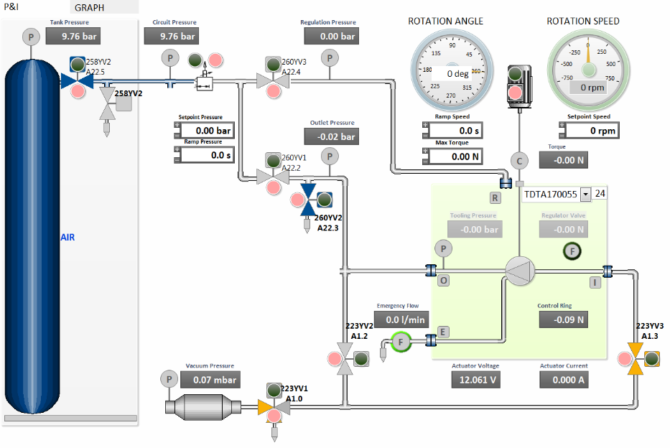
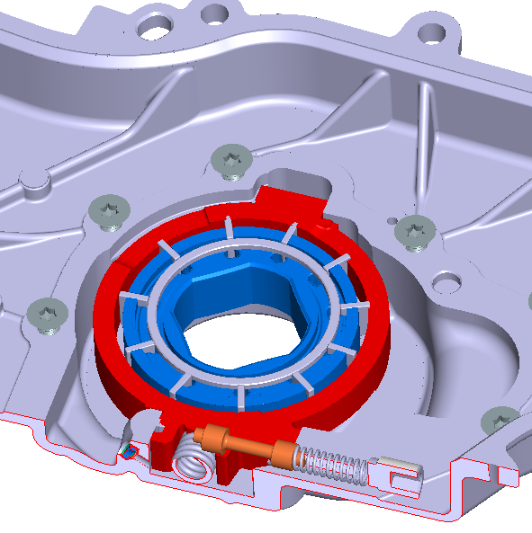
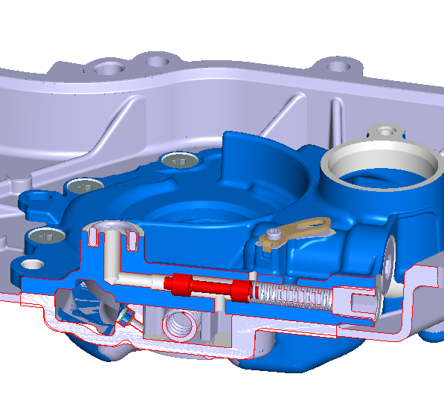
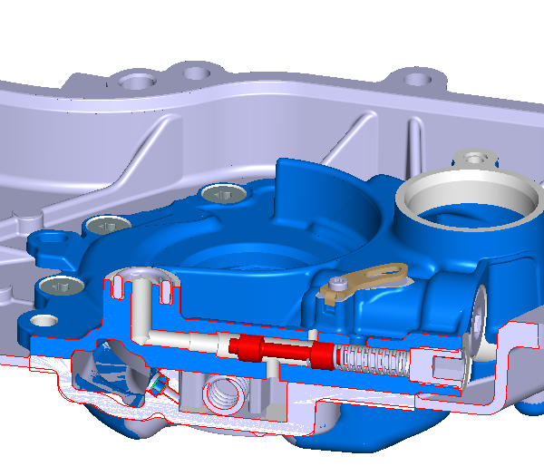
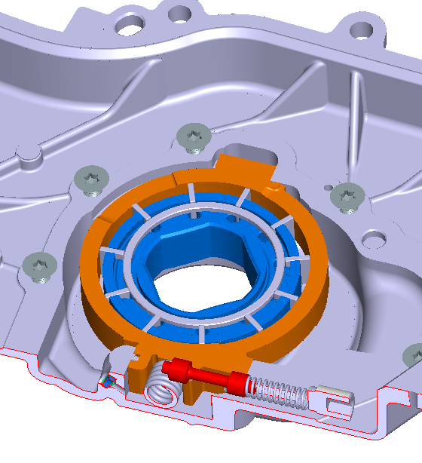
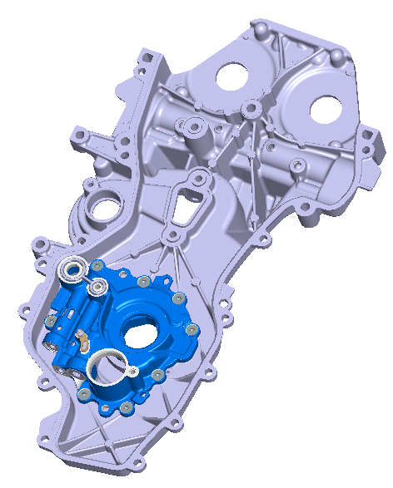
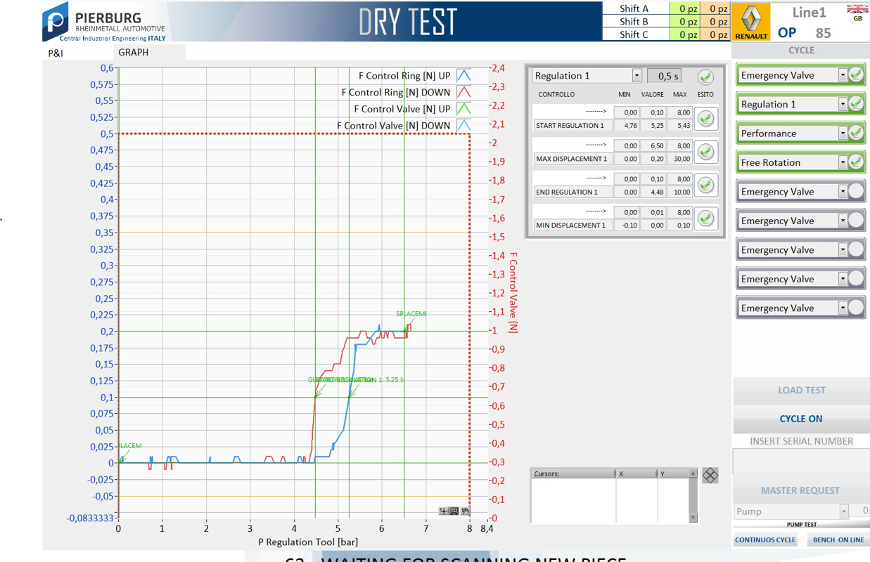
: PU2025-18- FTQ improvement for BR10 VOP- RR1 test NOK
System Description-Cartooning
DMAIC - DEFINE
Load Cell
Magnet
RR1 Test Pressure-Mone [Y]

Slide 8
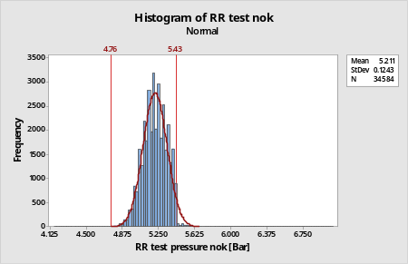
Project Definition Tree
: PU2025-18- FTQ improvement for BR10 VOP- RR1 test NOK
DMAIC - DEFINE
Project Statement: Find and control the Big X for BR10 VOP- Ring regulation1 test NOK Found at
MF1 Line1 End of line dry test station85 to reduce the FTQ rejection 1.49% & 1500 € estimated.
Rationale:
Feature
Property
Defect
Event
Strategy decision
Functional testing
Mone [Y]: Found in station85 EOL Dry test bench
Pareto: RR1 test nok is the top most FTQ concern for BR10 VOP
Malfunction
Destructive
Station85
Other
BR10 VOP
FAMB VOP
3D15 VOP
RR1 Test
Emergency Test
Performance Test
Free Rotation Test
Mone [Y] Description: RR1 test nok for higher pressure against the specification of 4.76 to 5.43 bar
Mone [Y] unit: Pressure in bar
Distribution of Mone (y)
RR1 NOK
8
Notes:
Please refer to the Shainin Pocket Guide for the tree standards.

Slide 9
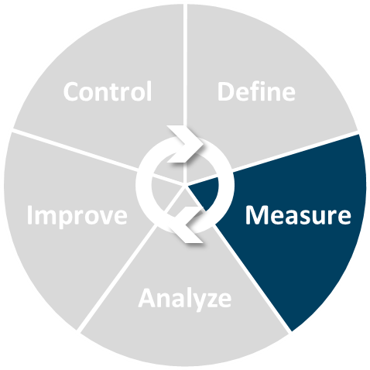
MEASURE
: PU2025-18- FTQ improvement for BR10 VOP- RR1 test NOK
DMAIC - MEASURE
Possible required tools like:
Process Flow Diagram ----------------------
Strategy Diagram --------------------------
Isograph -------------------------------------
Stage 0 --------------------------------------
Mone(Y) = Mass Flow [kg/s]
BIG X
Elimination Strategy

Slide 10
: PU2025-18- FTQ improvement for BR10 VOP- RR1 test NOK
Process Flow Diagram
DMAIC - MEASURE
Input
Operation
Function
Input
Operation
Function
Housing, Filter, setting ring spring, seal
Load pump on station 85
Press cycle start button
EV Test cycle.
RR1 Test cycle
Performance test cycle.
Free rotation test cycle.
Part releases and door opens
Pick pump and transfer for next station
Pump functional test
Station 05
Assembly of child parts
Regulation valve, Emergency Valve, spring and Plug
Station 10
Assembly of child parts
EV- 6.62 to 8.78 pressure in bar
Thermostat valve, Lamination valve, Limiter and Plug assembly
Pneumatic air supply
(10 to 13 bar)
RR1 pressure
4.76 to 5.43 bar
Station 20
Assembly of child parts
Performance test Min vacuum
≤ - 7.5 mbar
Rings, Vanes, cover and screws
Station 50
Assembly of child parts and Camera verification
Cover screwing, Screws
Station 80
Assembly of child parts
Free Rotation Test Limit Max Torque 0.25 Nm
FG Pump
Station 85
Pump dry test
FG Pump
Station 95
Laser Marking

Slide 11
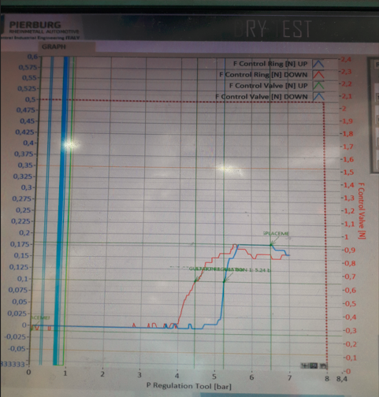
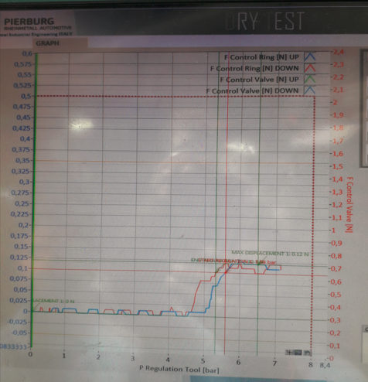
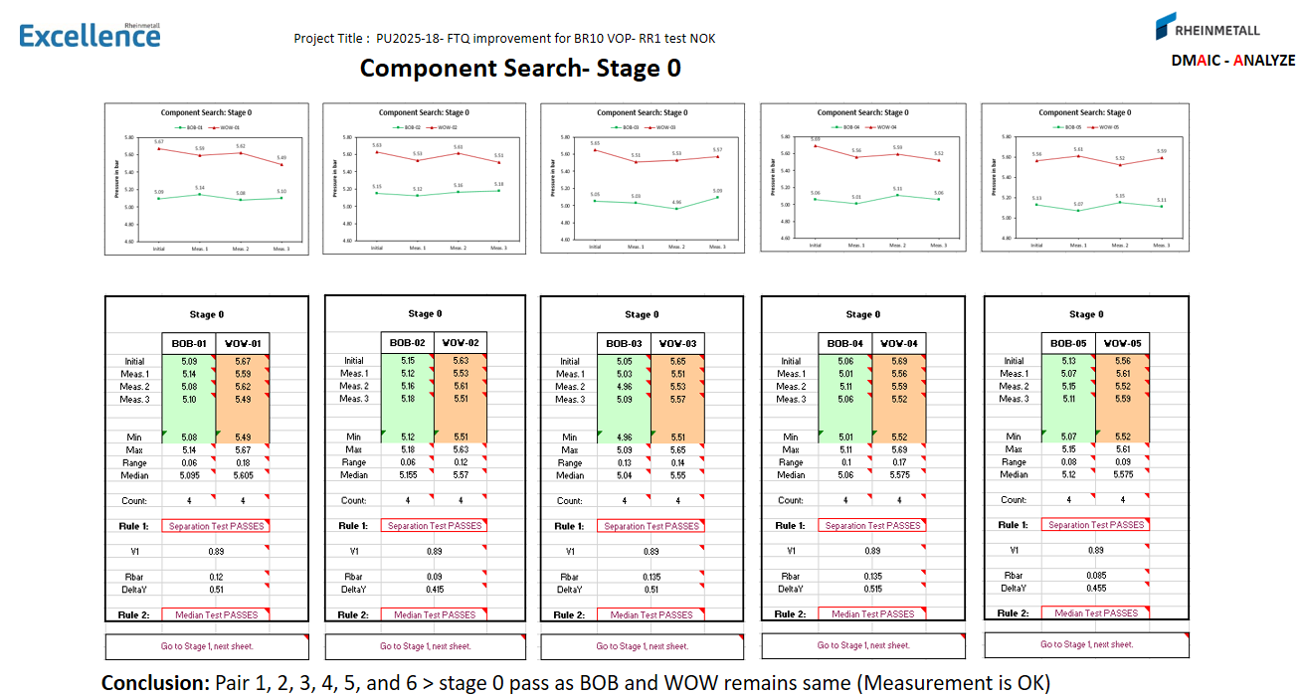
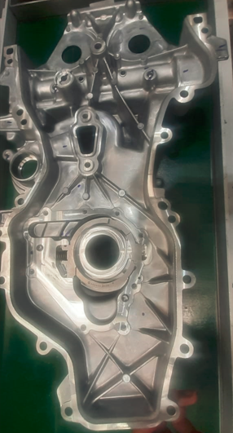
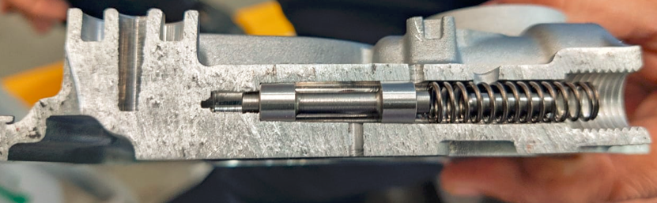
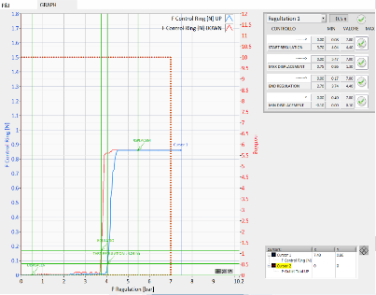
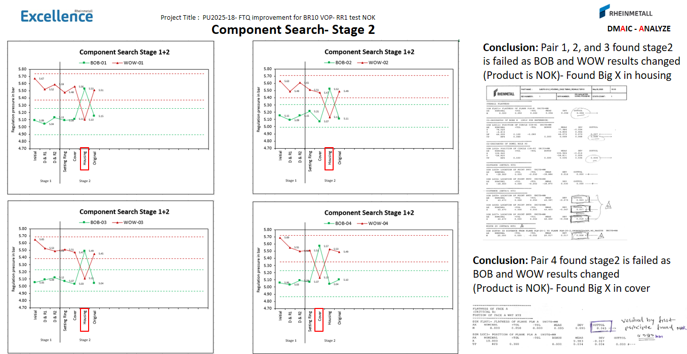
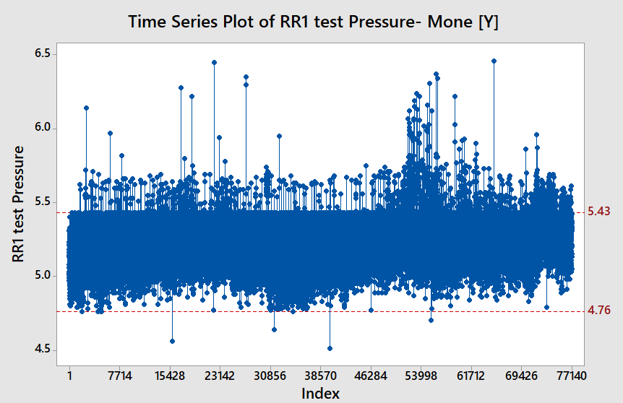
: PU2025-18- PU2025-18- FTQ improvement for BR10 VOP- RR1 test NOK
Malfunction Event Strategy Diagram
DMAIC - MEASURE
Mone(Y) = RR1 Regulation pressure in bar
Family of Variation
Contrast
Diagram
What Is Meant by Each Contrast
Do Not Know
Small / No
Point to Point
✓
BOB
WOW
Can not be established
Large
N/A
Same event
✓
Event to Event
Test bench measurement system is OK (Stage 0 pass)
Same Part
✓
Part to Part
Affected parts are Single in Pump
(Housing, Setting Ring, Cover, Valve & Spring)
Same Pump
✓
Pump to Pump
WOW Pump pressure observed 5.63 bar and BOB pump pressure observed 5. 06 bar against specification of 4.76 to 5.43 bar and stage2 is failed
Same Time
✓
Time to Time
Time series shows variation month to month.

Slide 12
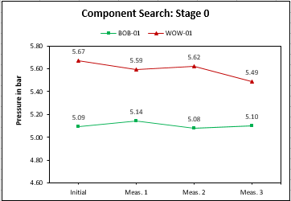
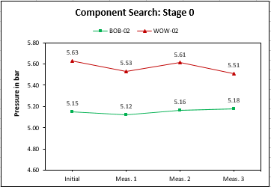
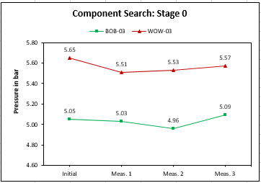
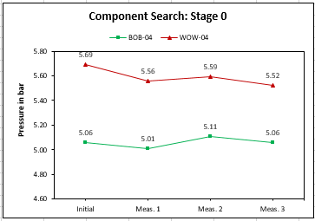
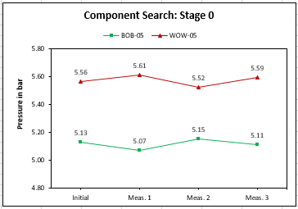
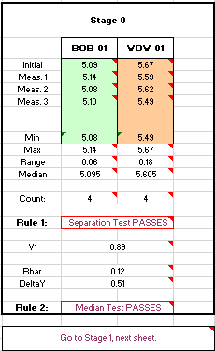
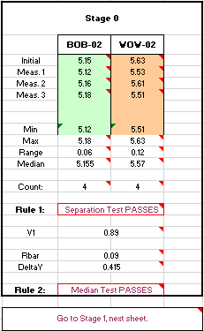
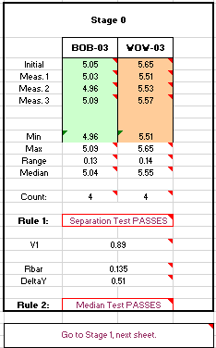


Project Title : PU2025-18- FTQ improvement for BR10 VOP- RR1 test NOK
Component Search- Stage 0
DMAIC - ANALYZE
Conclusion: Pair 1, 2, 3, 4, 5, and 6 > stage 0 pass as BOB and WOW remains same (Measurement is OK)

Slide 13
ANALYZE
Project Title : PU2025-18- FTQ improvement for BR10 VOP- RR1 test NOK
DMAIC - ANALYZE
Possible required tools like:
Component Search -----------
Concentration diagram-------
Paired Comparison----------
Solution Tree ------------------
Risk Assessment Matrix -----
Confirmation Testing ---------
Mone(Y) = Mass Flow [kg/s]
BIG X
Elimination Strategy

Slide 14
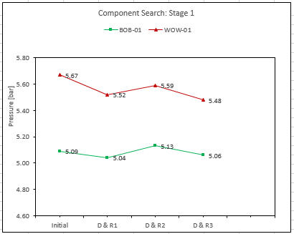
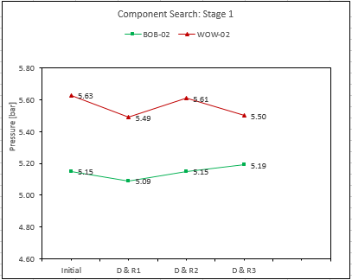
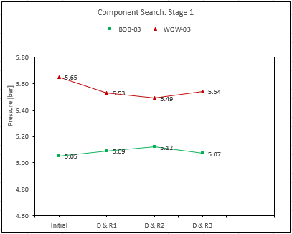
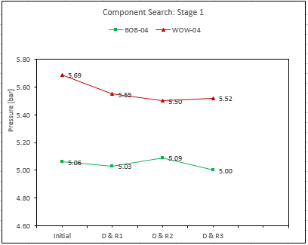
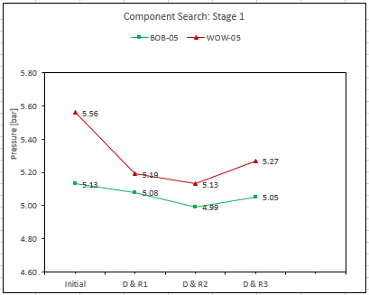
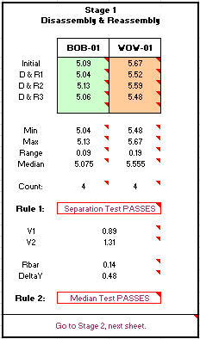
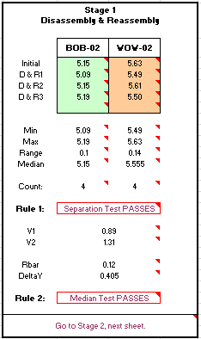

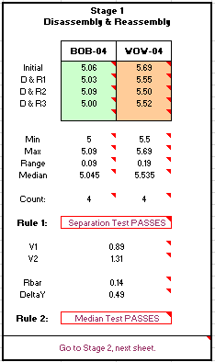

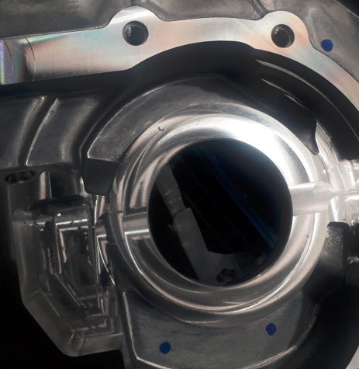
Project Title : PU2025-18- FTQ improvement for BR10 VOP- RR1 test NOK
Component Search- Stage 1
DMAIC - ANALYZE
Conclusion: Pair 1, 2, 3, and 4 found stage 1 passed as BOB and WOW remains same (Process is OK)
Burr- Contamination
found at rotor & setting ring area

Slide 15
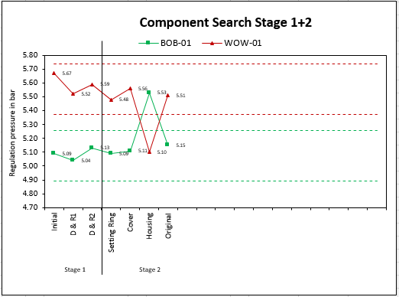
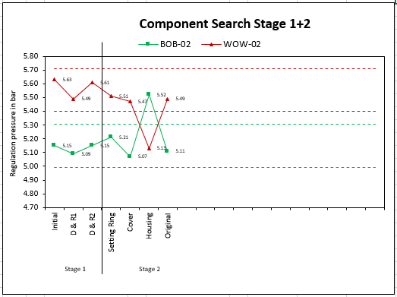
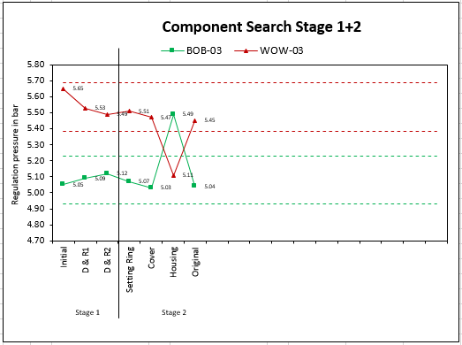
Project Title : PU2025-18- FTQ improvement for BR10 VOP- RR1 test NOK
Component Search- Stage 2
DMAIC - ANALYZE
Conclusion: Pair 1, 2, and 3 found housing as suspected BIG-X
as BOB and WOW results changed, sent for dimensional inspection

Slide 16
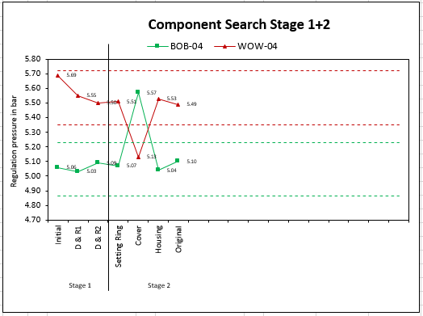
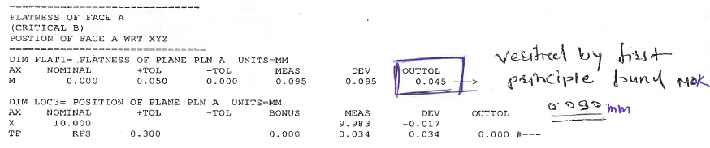
Project Title : PU2025-18- FTQ improvement for BR10 VOP- RR1 test NOK
Component Search- Stage 2
DMAIC - ANALYZE
Conclusion: Pair 4 found cover suspected, as BOB and WOW results changed and cover sent for for dimensional inspection
Conclusion: Cover flatness 0.050mm is the BIG-X

Slide 17
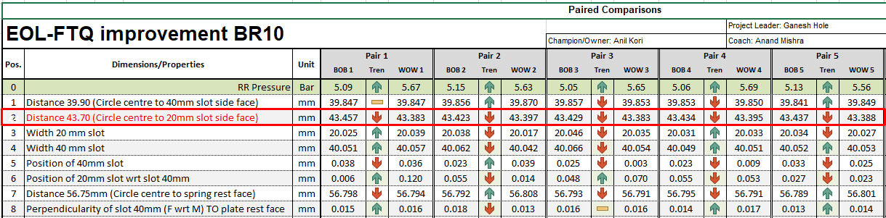
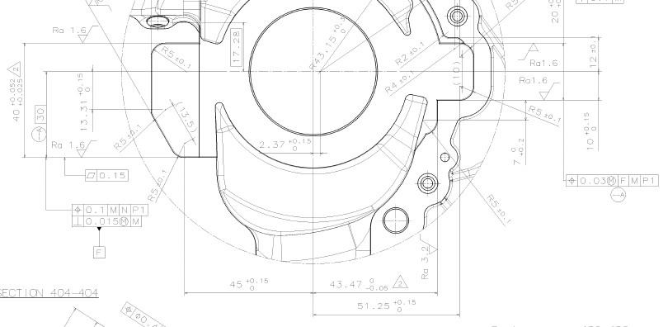
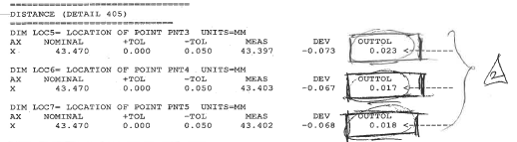
Project Title : PU2025-18- FTQ improvement for BR10 VOP- RR1 test NOK
Paired Comparisons
DMAIC - ANALYZE
Taken additional two pairs for analysis
Conclusion: Housing distance 43.70mm is the Big X

Slide 18
Solution Tree
Project Title : PU2025-18- FTQ improvement for BR10 VOP- RR1 test NOK
DMAIC - ANALYZE
Mone(Y)
Rationale:
ΔM
ΔP
Component search stage 0 → Passed
Component search stage 1→ Passed
Component search stage 2→ For Pair1, 2 and 3
swap analysis completed-BOB become WOW and
WOW become BOB, when housing is replaced.
Paired Comparison: Among the contributing parameters of
housing for RR1 high pressure, Housing distance 43.70mm
is the Big X (Machining at supplier end)
Assembly
Parts
Assembly process
Housing
Cover
Setting ring
Distance
Slot width
Position of Slot
Perpendicularity of slot
43.70 mm
39.90 mm
56.75 mm
20 mm
40 mm
20 mm
40 mm
40 mm
BIG-X is confirmed using B Vs W confirmation test
BIG X

Slide 19
Solution Tree
Project Title : PU2025-18- FTQ improvement for BR10 VOP- RR1 test NOK
DMAIC - ANALYZE
Mone(Y)
Rationale:
ΔM
ΔP
Component search stage 0 → Passed
Component search stage 1→ Passed
Component search stage 2→ For Pair 4, Swap analysis completed-BOB become WOW and WOW become BOB, when cover is replaced.
Cover flatness 0.050 max found out of specification,
is observed 0.095 mm (Machining at supplier end)
Assembly Parts
Assembly Process
Housing
Cover
Setting ring
Flatness of Face A
Position
Internal Diameter
Step Distance
0.050 mm
Face A- 0.030 mm
Dia. 3.0 mm hole
Dia. 4.0 mm hole
Dia. 8.0 mm hole
ID 8.0 mm
25.10 mm
BIG-X is confirmed using B Vs W confirmation test
BIG- X

Slide 20
Project Title : PU2025-18- FTQ improvement for BR10 VOP- RR1 test NOK
Risk Assessment Matrix- Housing
DMAIC - ANALYZE
The proposed change is: Housing dimensions as per drawing Date of assessment: 29.08.2025 What leader was involved in this discussion? Yes | Consequences of a wrong decision
 | Details | Low | Med | High
1. Will it cost a lot to implement the change? | Low - No cost involved | Insignificant | Moderate | Significant
2. Will it take a long time to implement the change? | Quick correction | Quickly | Moderate | Significant
3. Will it be easy to go reverse the change? | Low- Can be reversed easily | Completely Reversible | Partly Reversible | Non Reversible
4. Will it take a long time find out it wasn’t effective? | Low- No, as we do 100% EOL testing | Insignificant | Moderate | Significant
5. On going cost (€ or other losses ) if the change does not fix the problem. | Med- No, as we do 100% EOL testing | No Risks | Internal Risk | Customer Risk
6. Do we understand the physics of the problem? | Yes, fully understand | Fully Understand | Somewhat | Not Clear
7. Is there a risk of health damage? | No- Not impacting health | No | Somewhat | Significant
Overall Assessment of Risk: | is Low | Low | Medium | High
Decision Made Acceptable % of ´risk selected: 0.1 %, < 1 %, 5 %, 10 % order 50 % (If 50%, no confirmation test will be conducted because all risks judged LOW. This is called “Run Chart Confirmation”).
Conclusion: Since, Overall assessment of risk is low, need to go for B vs W confirmation Test

Slide 21
Project Title : PU2025-18- FTQ improvement for BR10 VOP- RR1 test NOK
Risk Assessment Matrix- Cover
DMAIC - ANALYZE
The proposed change is: Cover flatness Dimensions as per drawing Date of assessment: 29.08.2025 What leader was involved in this discussion? Yes | Consequences of a wrong decision
 | Details | Low | Med | High
1. Will it cost a lot to implement the change? | Low - No cost involved | Insignificant | Moderate | Significant
2. Will it take a long time to implement the change? | Quick correction | Quickly | Moderate | Significant
3. Will it be easy to go reverse the change? | Low- Can be reversed easily | Completely Reversible | Partly Reversible | Non Reversible
4. Will it take a long time find out it wasn’t effective? | Low- No, as we do 100% EOL testing | Insignificant | Moderate | Significant
5. On going cost (€ or other losses ) if the change does not fix the problem. | Med- No, as we do 100% EOL testing | No Risks | Internal Risk | Customer Risk
6. Do we understand the physics of the problem? | Yes, fully understand | Fully Understand | Somewhat | Not Clear
7. Is there a risk of health damage? | No- Not impacting health | No | Somewhat | Significant
Overall Assessment of Risk: | is Low | Low | Medium | High
Decision Made Acceptable % of ´risk selected: 0.1 %, < 1 %, 5 %, 10 % order 50 % (If 50%, no confirmation test will be conducted because all risks judged LOW. This is called “Run Chart Confirmation”).
Conclusion: Since, Overall assessment of risk is low, need to go for B vs W confirmation Test

Slide 22
Project Title : PU2025-18- FTQ improvement for BR10 VOP- RR1 test NOK
Confirmation Testing
DMAIC - ANALYZE
Confirmation Experiment Applied: B Vs W
Risk Level: 5%
Definition of BIG X parameter Groups:
X_{B}: Distance 43.423 - 43.457 mm
X_{W}: Distance 43.383 – 43.397 mm
Sample size B: 5
Sample Size W : 5
Mone (Y) response:
RR1 test pressure higher side against specification
4.76- 5.43 bar
Required End Count: 10
Run Order
Rank Order
Sample | Big X Distance 43.70 (mm) | Mone(Y) RR1 test pressure (bar)
BOB-01 | 43.451 | 5.03
WOW-01 | 43.385 | 5.63
BOB-02 | 43.427 | 5.19
WOW-02 | 43.390 | 5.55
BOB-03 | 43.445 | 5.08
WOW-03 | 43.386 | 5.60
BOB-04 | 43.433 | 5.15
WOW-04 | 43.394 | 5.51
BOB-05 | 43.436 | 5.10
WOW-05 | 43.389 | 5.57
Sample | Big X Distance 43.70 (mm) | Mone(Y) RR1 test pressure (bar)
BOB-01 | 43.451 | 5.03
BOB-03 | 43.445 | 5.08
BOB-05 | 43.436 | 5.10
BOB-04 | 43.433 | 5.15
BOB-02 | 43.427 | 5.19
WOW-04 | 43.394 | 5.51
WOW-02 | 43.390 | 5.55
WOW-05 | 43.389 | 5.57
WOW-03 | 43.386 | 5.60
WOW-01 | 43.385 | 5.63
BOB
WOW
End Count = 5+5= 10
Conclusion:
Confirmation test is passed, Distance 43.470 is the BIG X of Housing. There is a 5% risk that we have been fooled by these data
Notes:
Please refer to our website: www.Shainin.com, the Collaboration Platform and Reference Manual. A pdf document is available with guidelines and standards for this tool.
This TEST slide should be modified for the exact type of test that is being planned such as a B vs C or B vs W or a Barrier etc. The test risk level is determined by completing a Risk Assessment Matrix discussion.

Slide 23
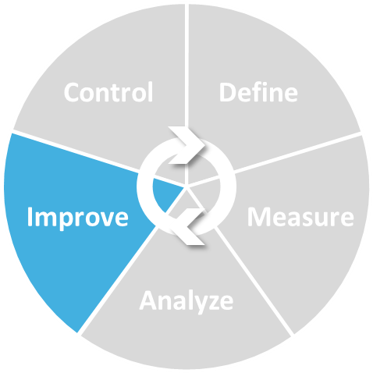
IMPROVE
: PU2025-18- FTQ improvement for BR10 VOP- RR1 test NOK
DMAIC - IMPROVE
Possible required tools like:
Understand Y → X Relationship-------
Action List---------------------------------
Scatter plot--------------------------------
Tolerance Parallelogram----------------
Mone(Y) = Mass Flow [kg/s]
BIG X
Elimination Strategy

Slide 24
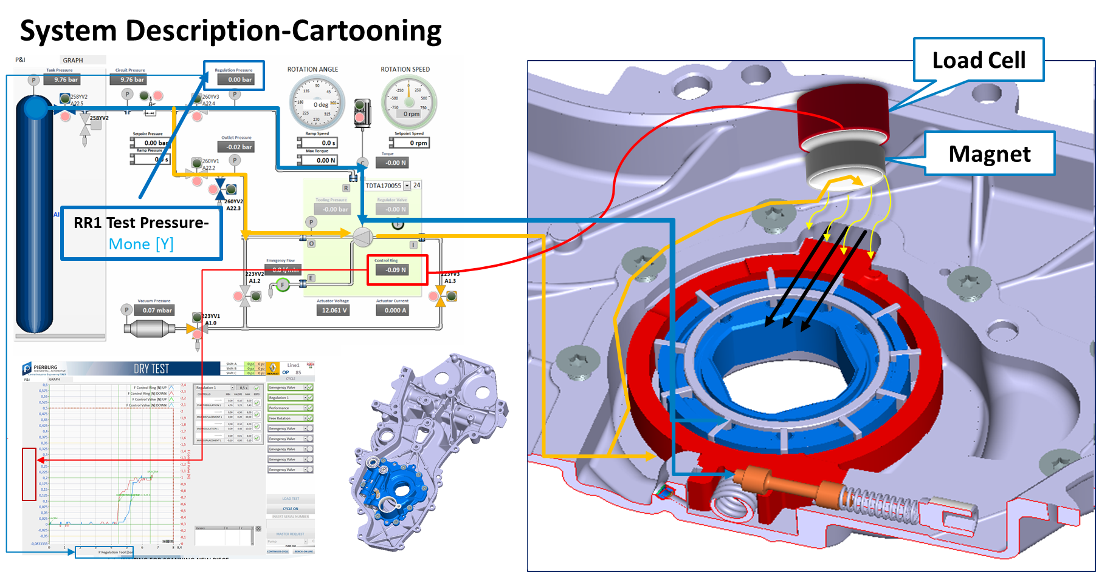

: PU2025-18- FTQ improvement for BR10 VOP- RR1 test NOK
Understand Y → X Relationship
DMAIC - IMPROVE
WOW
Mone [Y]
BOB
Mone [Y]
BIG-X
WOW
BIG-X
BOB
Conclusion:
Improvement in Mone [Y] if housing center distance 43.47 mm is within specification and if it is undersize then Mone [Y] gets out of specification at higher zone

Slide 25
: PU2023-19- FTQ improvement for BR10- RR1 test NOK
Action list- Rico Supplier
DMAIC - IMPROVE
Item | Description | Action | Deadline | Finished Date | Responsible | Status
1 | Risk assessment | With CFT review | 31.08.2025 | 29.08.2025 | CFT | Completed
2 | Confirmation test | Corrected batch BOB with WOW | 31.08.2025 | 29.08.2025 | Ganesh Hole | Completed
3 | CP & CPk Dist. 43.47 – 0.05 | To be maintain by supplier as per standard | 31.08.2025 | 18.09.2025 | Vaibhav Jogade & Rico | Completed
4 | PFMEA- Rico | PFMEA to be update | 31.08.2025 | 18.09.2025 | Rico | Completed
5 | Control Plan-Rico | Control to be update | 31.08.2025 | 18.09.2025 | Rico | Completed
6 | Housing Inspection method | For center distance altered to 3points method, for Large & Small width altered to plane method as like as KSPG | 26.06.2025 | 26.06.2025 | Rico | Completed
7 | Housing Inspection method | For position RICO currently inspection done as per drawing, altered from point to plane method | 26.06.2025 | 26.06.2025 | Rico | Completed
8 | Housing Inspection method | To align with KSPG method for position RICO to visit KSPG with measured samples to align. | 31.08.2025 | 18.09.2025 | Mahendra Potkule & Rico | Completed
9 | Drawing specification for 10mm position 10mm (slot) | To be revisit and releasing of new drawing-ECN MOM done for immediate start | 31.12.2025 31.12.2025 | 31.01.2026 18.09.2025 | Ram Shewale Vaibhav Jogade | WIP Completed
10 | Time series for Mone [Y] | To be plot and attach | 30.09.2025 | 30.09.2025 | Ganesh Hole | Completed

Slide 26
: PU2023-19- FTQ improvement for BR10- RR1 test NOK
Action list- Rockman Supplier
DMAIC - IMPROVE
Item | Description | Action | Deadline | Finished Date | Responsible | Status
1 | Cutter entry location | Cutter entry location changed to “Over Clamp” (2) | 13.06.2025 | 14.06.2025 | Om Parkash | Completed
2 | Nylon Brush application | Nylon Brush removed | 13.06.2025 | 14.06.2025 | Om Parkash | Completed
3 | Inspection method | Inspection method restored by filler gauge. | 13.06.2025 | 14.06.2025 | Mohan Ram | Completed
4 | Flatness inspection | Flatness inspection by filler gauge confirmation marking being done. | 13.06.2025 | 14.06.2025 | Mohan Ram | Completed
5 | Training | Training provided to all line inspector about reported defect. | 13.06.2025 | 14.06.2025 | Rohit | Completed
6 | Quality alert | Quality alert displayed at PDI station. | 13.06.2025 | 14.06.2025 | Rohit | Completed
7 | Work Instruction | 100% inspection check point added in W.I for Flatness Not Ok by 0.039 mm | 23.06.2025 | 23.06.2025 | Rohit | Completed
8 | Control Plan | Control plan to be update for Flatness Not Ok by 0.039 mm | 23.06.2025 | 23.06.2025 | Naveen | Completed
9 | FMEA | FMEA to be update for Flatness Not Ok by 0.039 mm | 23.06.2025 | 23.06.2025 | Naveen | Completed

Slide 27

: PU2023-19- FTQ improvement for BR10- RR1 test NOK
Action list- Richo Supplier
DMAIC - IMPROVE
Item | Description | Action | Deadline | Finished Date | Responsible | Status
3 | CP & CPk Dist. 43.47 – 0.05 | To be maintain by supplier as per standard | 31.08.2025 | 18.09.2025 | Vaibhav Jogade & Rico | Completed
Quarterly basis CP & CPK demanded from supplier

Slide 28


: PU2023-19- FTQ improvement for BR10- RR1 test NOK
Action list- Richo Supplier
DMAIC - IMPROVE
Item | Description | Action | Deadline | Finished Date | Responsible | Status
9 | Drawing specification for 10mm position 10mm (slot) | To be revisit and releasing of new drawing-ECN MOM done for immediate start | 31.12.2025 | 31.01.2026 | Ram Shewale | WIP
BEFORE PHOTO- Drawing specification
AFTER PHOTO- Drawing specification
ECN to be done & new drawing to be release after change

Slide 29

: PU2023-19- FTQ improvement for BR10- RR1 test NOK
Action list- Richo Supplier
DMAIC - IMPROVE
Item | Description | Action | Deadline | Finished Date | Responsible | Status
9 | Drawing specification for 10mm position 10mm (slot) | MOM done for immediate start | 31.12.2025 | 18.09.2025 | Vaibhav Jogade | Completed
AFTER PHOTO-MOM with Rico supplier

Slide 30


: PU2023-19- FTQ improvement for BR10- RR1 test NOK
Action list- Rico Supplier
DMAIC - IMPROVE
Item | Description | Action | Deadline | Finished Date | Responsible | Status
10 | Time series for Mone [Y] | To be plot and attach | 30.09.2025 | 30.09.2025 | Ganesh Hole | Completed
BEFORE
AFTER

Slide 31

CONTROL
: PU2025-18- FTQ improvement for BR10 VOP- RR1 test NOK
DMAIC - CONTROL
Possible required tools like:
Run Chart ------------------------
P Chart ---------------------------
Time Series Plot ---------------
Mone(Y) = Mass Flow [kg/s]
BIG X
Elimination Strategy

Slide 32

: PU2025-18- FTQ improvement for BR10- RR1 test NOK
Apply Corrective Actions
DMAIC - CONTROL
Corrective action(s) identified: Housing & Cover dimensions maintain with specification
Effectiveness verified: Yes, Improvement in Mone [Y] if housing center distance 43.47 mm is within specification and if it is undersize then Mone [Y] gets out of specification at higher zone
Corrective action(s) procedurealized: Incoming inspection plan, Control plan, PFMEA is going to update
Project duration: 10 Feb 2025 – 31 Dec 2025
Cost savings / Impact: 1576.06 Euro
Housing distance 43.70 undersize by 0.023mm
Housing dia. 10mm [slot] position nok by 0.013mm

Slide 33















Project /WS Name: PU2025-18-FTQ improvement for BR10 VOP- RR1 test NOK
Project Leader: Mr. Ganesh Hole- 6003
Champion: Mr. Anil Kori
Coach: Mr. Anand Mishra
Plant/Dept.: Pune / Production
Start Date: 10.02.2025
End Date:
Last updated date: 18.12.2025
100 %
100 %
100 %
100 %
Current situation: BR10 VOP-RR1 Test is getting nok & observed OEE loss, FTQ loss & resource losses like manpower, machines for re-produce it & resulting for no on time delivery to the customer.
Observation & Data & Graphs & Pictures
Observation & Data & Graphs & Pictures
Explanation & Data & Graphs & Pictures
BR10-RR1 Test is the Top most FTQ concern for BR10 vop
Current rejection percentage is 1.49% for Jan 2025
Project statement & goal definition
Find and control the big X for BR10 VOP- Ring regulation1 test NOK Found at MF1-Line 1-End of line dry test, station-85 to reduce the FTQ rejection 1.49% and save 1500 € estimated.
Impacted KPI：FTQ
Current state of KPI：1.49%
Expected KPI Target or project goals= 0.29%
Expected benefits including estimated saving: 1500 €
Result / Conclusion: Drawing specification to be revised
100 %
0 %
Before x After including sustainability confirmation
Project team & resources : Mr. Shahiraj Shelar- Prod., Mr. Ramesh Sawant-Prod., Mr. Shriram- QA, Mr. Vaibhav Jogade- QA
Result / Conclusion: D.R. value is ≥ 6 means measurement system is OK (Good Sausage)
In case of project charter adding screen shot is possible
Expected project goal met? YES - NO - WITH DEVIATION
Project is under Control phase- As BR10 VOP housing is customer directed supplier, effectiveness is not there because of dimensions are frequently nok in housing.
Result / Conclusion: Housing dimension 43.27mm undersize and cover flatness nok is the BigX
Champion feedback: Project APPROVED YES - NO
1576.06 €

Slide 34
CONTROL
Review of Project Lessons Learned & Identification of Best Practices
: PU2025-18- FTQ improvement for BR10- RR1 test NOK
DMAIC - CONTROL
Plant:
Pune
Product group(s):
BR10 VDOP
Affected Process (es):
Assembly process (EOL)
Impacted KPI(s):
FTQ
BR10 VOP RR1 test nok rejection is yet not improved as per target goal
Through this project we learn that the housing center 43.47mm undersize
can contribute for RR1 test nok (Housing machined at supplier end)
Detail Understanding of process , Y - X relationship & Confirmation of BIG-X
What did we do well in the project?
What should we have done in another way?
Technical & Result Lessons
Was it a good project based on achieved project results?
What could we learn for future to prevent doing same mistakes in similar processes? (e.g. less mistakes, higher quality, less costs, faster)
NA
Project Performance Lessons
  Review of PM procedures and practices to manage and perform the project:
  How was the project defined? / planned? / governed? / executed? / monitored?
    How did the team perform?
Monthly project is reviewed with Management Team
CFT Involvement
NA
Best Practices?
Which output/finding/solution etc. could be an inspiration for other plants?
Horizontal deployment for similar pumps,
As lesson learned taken for Line3 & Line4 EOL
Improvement Ideas / Suggestions?
If we do such a project again, what should we do differently?
Create inspection plan for housing and start of sampling inspection at KSPG receipt stage

Slide 35


: PU2025-18- FTQ improvement for BR10 VOP- RR1 test NOK
DMAIC - CONTROL

Slide 36
: PU2023-19- FTQ improvement for BR10- RR1 test NOK

